Slide 1
IoT Approach to Accommodation & Booking Related Web Services
Ivan Pavkovic, e1428704
Advanced Services Engineering
184.742, VU, 2015S

Slide 2
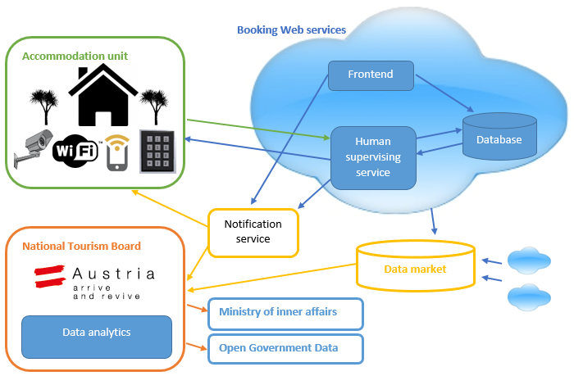
Proposed platform
Different points of view:
Tourist
Accommodation owner
Tourism board
Tax administration
Ministry of inner Affairs
Advanced Services Engineering
184.742, VU, 2015S
Notes:
-Tourist books app
-WiFi, cameras and NFC smart doors a entrance
-Download of key from wifi, camera confirmation because of NFC exploits
-No "man in the middle"
Data further sent to TB, Ministry IA and Tax administration More data exported to data marketplace

Slide 3
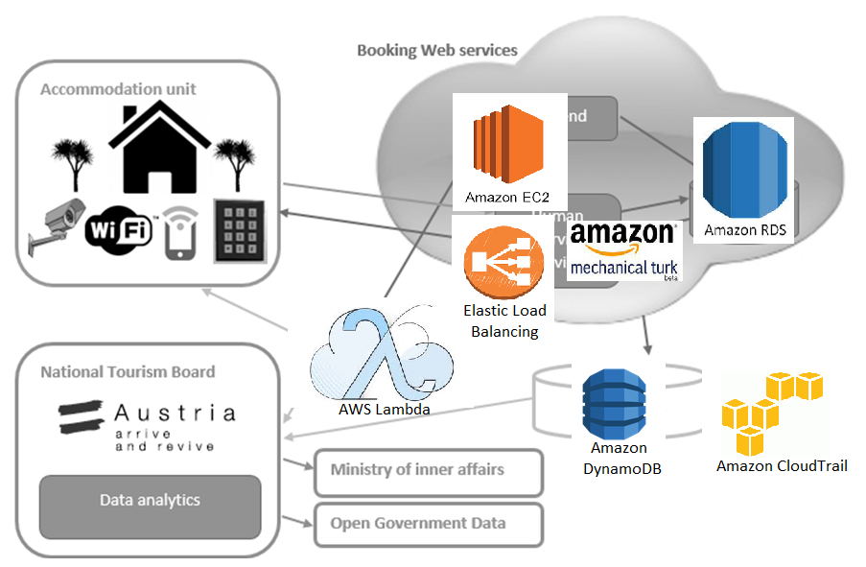
Platform services
Advanced Services Engineering
184.742, VU, 2015S
Notes:
Amazon EC2 - Amazon EC2 provides resizable compute capacity in the cloud. It is designed to make web-scale computing easier for developers and system administrators. Different Web services in our application use this service.
AWS Lambda - AWS Lambda is a compute service that runs your code in response to events and automatically manages the compute resources for you, making it easy to build applications that respond quickly to new information. In our solution, AWS Lambda is used as a notification service.
Elastic Load Balancing - Elastic Load Balancing automatically distributes incoming application traffic across multiple Amazon EC2 instances. In our solution, it manages the data from different Web services, as well as different IOT devices.
Amazon RDS and Amazon DynamoDB - Amazon RDS (Relational Database Service) is a relational database in the cloud. Dynamo DB Amazon DynamoDB is a fast and flexible NoSQL database service for all applications that need consistent, single-digit millisecond latency at any scale. Our solution uses RDS as a background database and DynamoDB for data marketplace (and analytics).
AWS CloudTrail - AWS CloudTrail is a web service that records AWS API calls for your account and delivers log files to you. In our application is used to monitor usage of the IOT services we provide to other Web services (e.g. generation of new NFC key after booking on AirBnB.com).
Amazon Mechanical Turk - Amazon Mechanical Turk is a marketplace for work that requires human intelligence. The Mechanical Turk service gives businesses access to a diverse, on-demand, scalable workforce and gives Workers a selection of thousands of tasks to complete whenever it's convenient. In our application, we use it as Human supervising service , e.g. a person that supervises tourist’s check-in over cameras and confirms his identity)

Slide 4
Data concerns
Data from:
Sensors
Web services
Must:
Reporting arrival
Tourist board
Ministry of IA
Reporting income
Tax administration
PRIVACY
RUDIMENTARY DATA
More data?
Basics without ID
Behavioral data
Browsing habits
Feedback data
Advanced Services Engineering
184.742, VU, 2015S
Notes:
Basic data about tourist’s stay – number of people, country of origin, location of stay and duration
Behavioral data about the tourist – tourist’s info and travel habits, such as about his previous travels or friends. These data can be particularly rich if the user has connected his accommodation-related Web service account with his social networking account
Tourist’s browsing habits - The consultants of Expedia, one of the largest booking Web services, emphasized in their latest study [7] that travelers from UK and USA pay visits to 36.5 different travel websites in a 45 day period, prior to their booking. These data can provide many different information regarding his browsing habits.
Feedback data – Tourist’s final satisfaction regarding his stay

Slide 5
Data concerns
Interested parties:
Tourism boards
Countries
Accommodation owners
Provisioning:
QoD
Granularity
REST API
Advanced Services Engineering
184.742, VU, 2015S

Slide 6
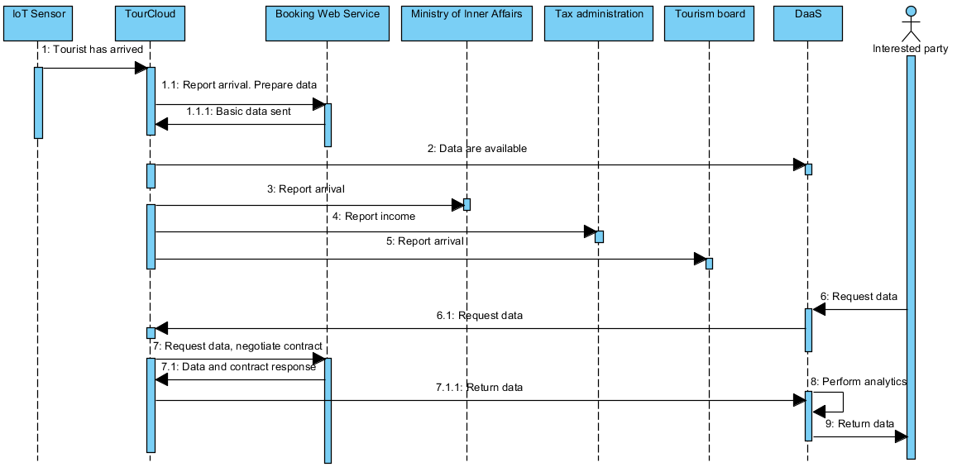
SEQUENCE DIAGRAM
Advanced Services Engineering
184.742, VU, 2015S

Slide 7
IMPLEMENTATION
Advanced Services Engineering
184.742, VU, 2015S

Slide 8
Implementation
PHP (frontend + backend)
JAVA(interaction with other services)
BOOTSTRAP
Example of Croatia
Online at http://188.166.27.247/touristigo/index/
Wont stay there too long
Advanced Services Engineering
184.742, VU, 2015S

Slide 9
Tourist’s arrival
Tourist identifies itself at arrival by one of the methods
Amazon Mechanical Turk Worker confirms his arrival
mTurk SDK, “ant survey”
Advanced Services Engineering
184.742, VU, 2015S

Slide 10
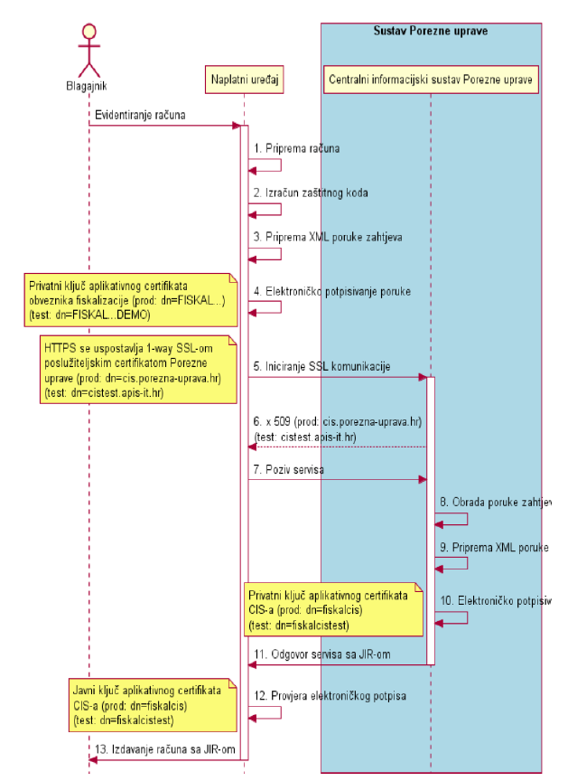
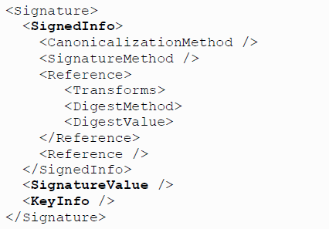
Reporting arrival
To Tax administration
To local Tourism board
Advanced Services Engineering
184.742, VU, 2015S

Slide 11
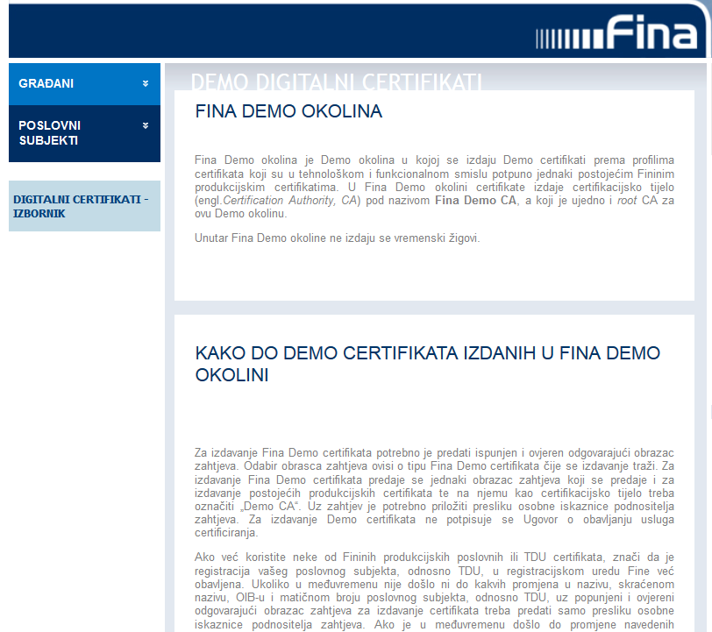
Reporting arrival
To Tax administration
http://www.fina.hr/Default.aspx?art=10761
http://www.porezna-uprava.hr/HR_Fiskalizacija/Aktualnosti%20dokumenti/Tehni%C4%8Dke%20specifikacije/Tehni%C4%8Dka%20specifikacija%20za%20korisnike%201.2.pdf
Advanced Services Engineering
184.742, VU, 2015S

Slide 12
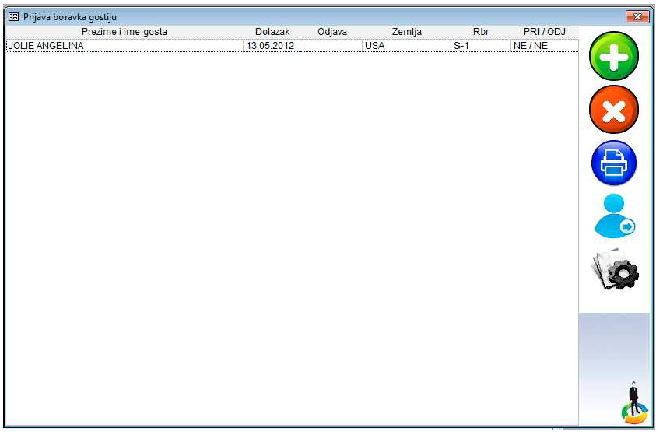
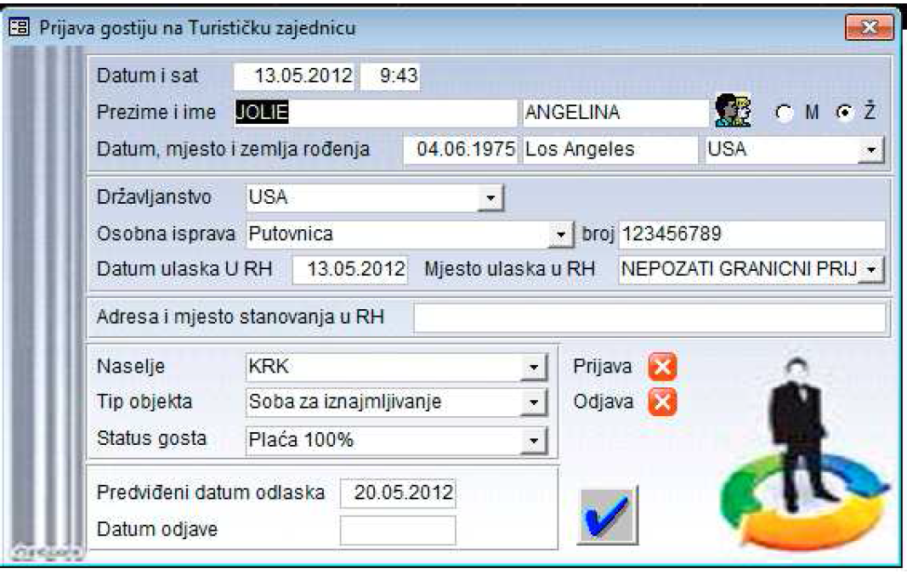
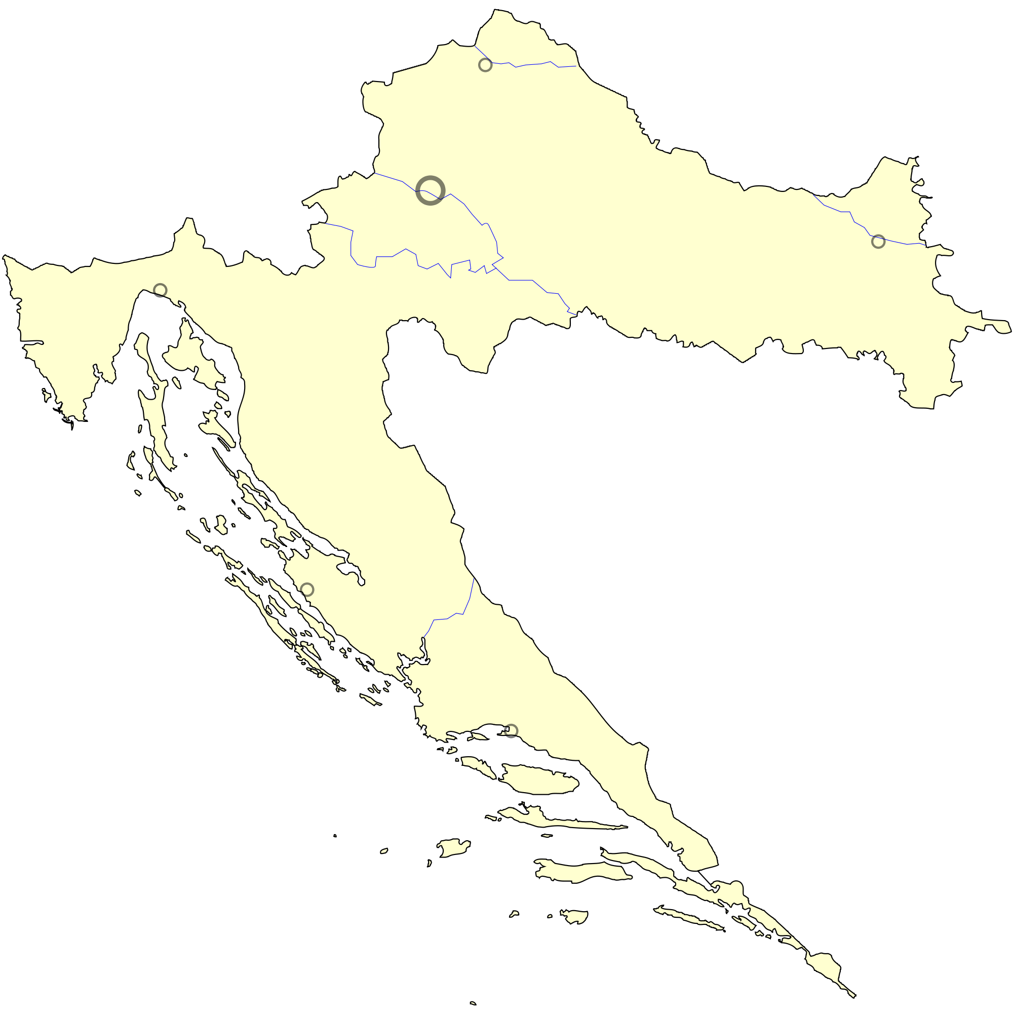
Reporting arrival
To local Tourism Board
Current state
Advanced Services Engineering
184.742, VU, 2015S

Slide 13
Data marketplace
AWS DynamoDB
Provisioning models & QoD
Advanced Services Engineering
184.742, VU, 2015S

Slide 14
THANK YOU !
Advanced Services Engineering
184.742, VU, 2015S

